Slide 1
HOSPITAL PATIENT RECORD SYSTEM
Duaa Farooq ct-058
Eman Siddiqui ct-072

Slide 2
INDEX
ABSTRACT
INTRODUCTION
OBJECTIVES
HOW IT WAS SOLVED
ARCHITECTURE OF THE SYSTEM
FLOWCHART
RESULTS
ASSUMPTION
CONCLUSION

Slide 3
ABSTRACT:
In today’s healthcare system, managing patient information properly plays a very important role in providing smooth and effective medical services. Every day, hospitals and clinics handle a large number of patients, and keeping their records accurate and up to date can be a difficult task. Many healthcare centers still depend on paper files to record patient details, which can easily be misplaced, damaged, or take too long to search through. These problems often lead to delays in treatment, repeated tests, and unnecessary confusion. To overcome such challenges, this project introduces a Patient Record System developed in the C programming language.

Slide 4
INTRODUCTION:
This system is designed to help hospitals and clinics store and manage patient information in a simple and organized way. It allows users to enter details such as the patient’s name, disease, age, and a unique ID number. Once entered, the program makes it easy to view all patient records, search for a patient by ID or disease, and even update information whenever needed. The use of arrays and functions in C helps in storing and managing the data efficiently.
Although this version of the project stores data temporarily in memory, it can be further improved by adding new features such as saving records permanently using file handling, deleting old records, and adding data validation to prevent incorrect entries. In the future, it can also be connected to a database to handle a larger number of patients or linked with hospital management software for more advanced use.
Overall, this project shows how computer programming can solve real-life problems in the healthcare field. By converting manual record-keeping into a digital process, the Patient Record System makes it easier, faster, and safer to manage patient data. It is a small but meaningful step toward the digital transformation of healthcare, ensuring that technology benefits not only large hospitals but also small clinics and local health centers.

Slide 5
OBJECTIVES:
The main aim of this project is to develop a simple and effective Patient Record System that helps manage patient information digitally. The system is designed to:
Provide Organized Record-Keeping: Ensure that patient details are stored in a clear and structured way for easy access.
Improve Efficiency: Reduce the time and effort required to find, update, or maintain patient records.
Minimize Errors: Decrease mistakes that often occur in manual paper-based record-keeping.
Be Easy to Use: Create a user-friendly system that can be used by hospital or clinic staff without technical expertise.
Support Learning and Understanding Serve as a practical example for students and beginners to understand basic programming concepts like arrays, functions, and conditional statements, while solving a real-world problem.

Slide 6
HOW IT WAS SOLVED?
To solve the problem of managing patient records manually, we developed a simple and user-friendly program in C language. The system allows basic operations like adding, viewing, searching, and updating patient information efficiently
Each patient’s record includes an ID, name, disease, and age. Functions and arrays were used to handle multiple patients easily. The program uses a menu-driven structure, so users can perform actions just by selecting options from the menu.
The logic was kept simple using loops, conditions and the strcmp() function for searching disease. Overall this PATIENT RECORD SYSTEM provides quick organized and error free way to manage patient data digitally.

Slide 7
ARCHITECTURE OF THE SYSTEM:
The Patient Record System is designed using a modular and simple architecture that allows easy management of patient information. The system is console-based and built using the C programming language. Its architecture can be understood in terms of data storage, main modules, and program flow.

Slide 8
DATA STORAGE
All patient information is stored temporarily in arrays. Each patient has four main attributes:
• ID – a unique number automatically assigned to each patient.
• Name – the patient’s full name.
• Disease – the illness or condition of the patient.
• Age – the patient’s age.
Arrays are used to store multiple patient records, making it possible to manage up to 50 patients in the current system.

Slide 9
2. MODULES OF THE SYSTEM
The program is divided into different functions (modules), each responsible for a specific task:
1. The add_patient() function lets users add a new patient by entering their name, disease, and age. The program automatically assigns a new ID to each patient.
2. The view_patient() function displays all the patient records stored in the system in a clean and organized way.
3. The search_patient_by_id() and search_patient_by_disease() functions make it easy to find a particular patient or a group of patients by entering their ID or disease name.
4. The update_patient() function allows the user to change any existing patient’s details, such as name, disease, or age, if any corrections are needed.

Slide 10
3. PROGRAM FLOW
The system uses a menu-driven approach to interact with the user. When the program runs, it repeatedly shows a menu with all available options. The user selects an option by entering a number, and the corresponding function is executed. This loop continues until the user chooses to exit the program.

Slide 11
4. TECHNICAL TERMS and DATA HANDLING
Arrays are used to store multiple patient records. They allow multiple records to be managed simultaneously in memory.
The program uses loops to traverse arrays and access records.
Different functions are used for specific task. Each major operation, adding, viewing, searching, and updating patients is defined as a separate function to keep the program modular and organized.
Conditional statements Employed to control program flow and handle user choices effectively within the menu-driven system.
String comparison functions (like strcmp) are used when searching patients by disease.
Data Handling-- Data is stored temporarily in arrays during program execution. Input and output operations rely on standard console interaction for entering and displaying records.

Slide 12
5. SCALABILITY
The system architecture is simple but modular, which allows future improvements, such as:
Storing data permanently using file handling.
Adding features like deletion of records.
Integrating with a database for handling larger datasets.
In short, the architecture is functional, easy to understand, and flexible, making it suitable for small hospitals, clinics, and as a learning project for programming students.

Slide 13
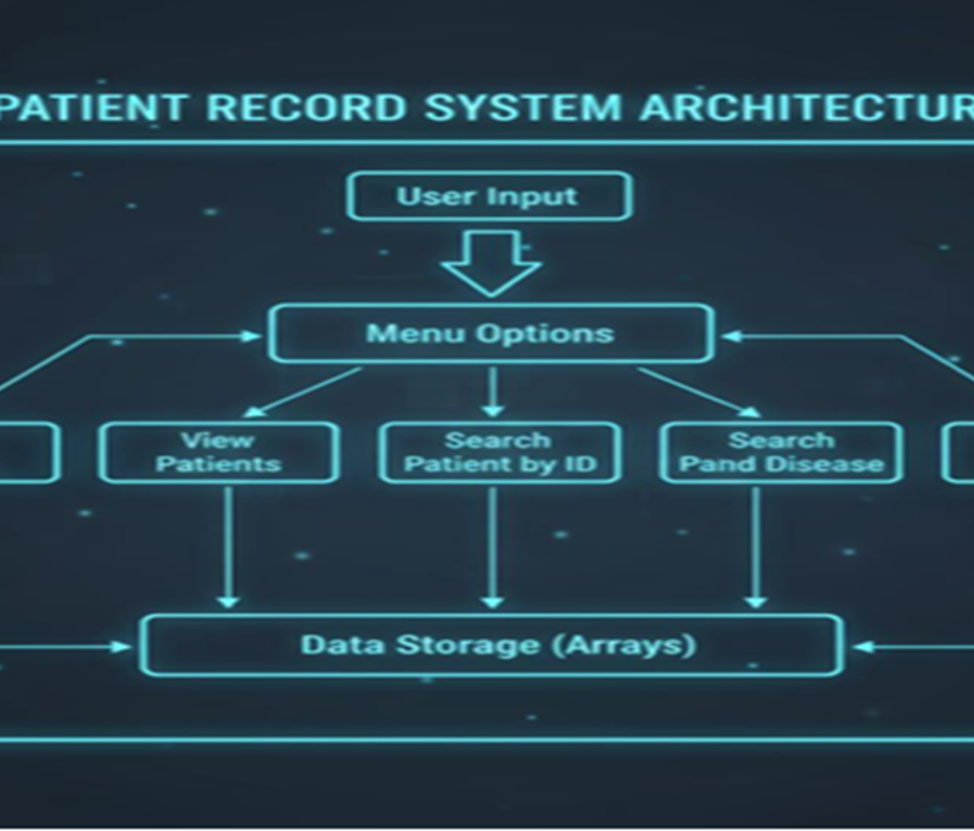
ARCHITECTURE OF THE SYSTEM

Slide 14
RESULTS:
ASSUMPTIONS:
Successfully added and displayed multiple patient records.
Search operations by ID and disease performed accurately.
Updates to existing records reflected immediately.
Menu interface functioned smoothly without logical errors.
System validated through multiple input test cases.
A maximum of 50 patient records can be managed.
The system runs in a standard console-based C environment.
Data is entered correctly by users (no validation errors).
Data is stored temporarily (no file handling implemented).

Slide 15
CONCLUSIONS:
The Patient Record System successfully establishes a reliable digital framework for keeping track of patient details. By storing all essential information in an organized manner, the system ensures that data is consistent and ready for immediate access whenever needed. The menu driven design and modular functions provide a clear structure, allowing smooth execution of tasks without confusion.
The system highlights how even a simple software solution can streamline administrative tasks, reduce the possibility of mistakes, and maintain proper records over time. Its straightforward architecture also allows easy expansion, making it suitable for smaller healthcare centers as well as for learning purposes.
Overall, this project proves that well-structured digital tools can bring efficiency, order, and reliability to patient management, supporting better operational practices in healthcare environments.

